Slide 1

What drives the price of a car?
Notes:
To change the image on this slide, select the picture and delete it. Then click the Pictures icon in the placeholder to insert your own image.

Slide 2
What drives the price of the car ?
Features considered in car sales
Visual plots with the findings
Recommendation to the dealer

Slide 3
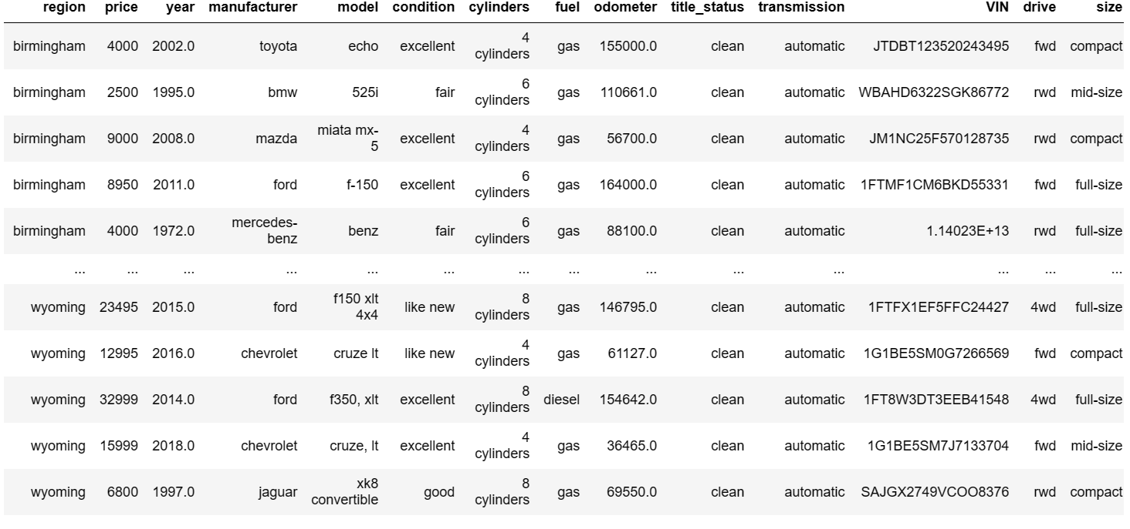
Key data set features
Car price
Year
Cylinders
Fuel type
Odometer
Size
Title status

Slide 4
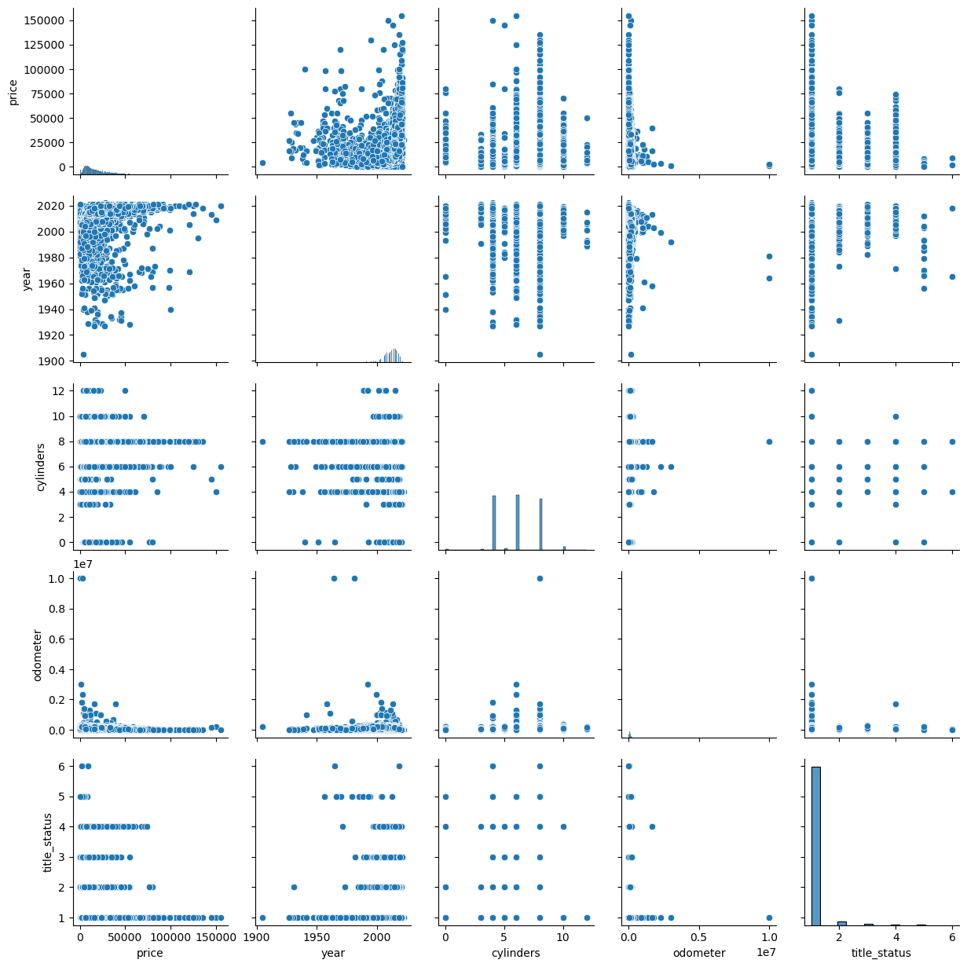
Factors impacting the Price
Latest the year of the car, prices are increasing
4,6 and 8 cylinders cars are moving fast
Lesser mileage on the car, higher are the price
Clean title status is must for the resale.

Slide 5
Recommendations
Recent Year model , lesser mileage and with clean title have higher price.
As the mileage increases the price of the vehicle seems to be reducing
Price of the car is not even across states
Electric vehicles are not yet a favored vehicle in the resale market
4, 6 and 8 cylinders are fast moving and having good price compared to other cylinders.

Slide 6
Thank You

